Slide 1
Heuristic Evaluation
Sara Muneeb
sara.muneeb@cuilahore.edu.pk
Computer Science Department

Slide 2
Heuristic Evaluation
Small team of evaluators (usually usability specialists) systematically checks interface design against small set of recognized usability principles (the “heuristics”).
Revised list of usability heuristics from [2]. The category names in brackets are the original names of the corresponding categories from [3], in those cases where they are different

Slide 3
Performing Heuristic Evaluation
Design may be verbal description, paper mock-up, working prototype, or running system.
Provide evaluators with checklist of usability heuristics.
Optionally provide evaluators with some domain-specific training.
Each evaluator works alone (1–2 hours).
Interface examined in two passes: first pass focuses on general flow, second on particular elements in detail.
Notes taken either by evaluator or evaluation manager.
Make list of potential problems and list of positive findings.
Take screen shots (in PNG) as you work - they may not be reproducible later.

Slide 4
Performing a Heuristic Evaluation
Independent findings are then aggregated into one large list (by evaluation manager). This is best done with a spreadsheet.
The large list of potential problems is distributed to each evaluator.
Each evaluator now assigns severity ratings individually to each problem in the large list (unseen by the other evaluators).
The individual severity ratings are averaged to obtain the final severity rating for each problem.
The long list is sorted in decreasing order of average severity. Now you know why a spreadsheet comes in handy.
Group debriefing session to suggest possible redesigns.

Slide 5
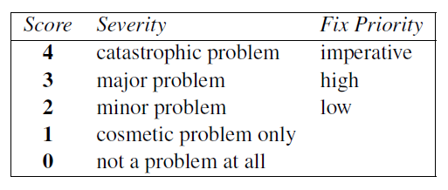
Severity Ratings
Severity ratings can help prioritise the fixing of usability problems.
After evaluation sessions, a complete aggregate list of usability problems is given/sent to each evaluator.
Working independently, evaluators assign severity rating [on scale of 0–4] to each problem (30 mins.).
Severity rating of single evaluator is unreliable, mean of 3–5 evaluators is satisfactory.

Slide 6
Experience of Evaluators
The experience of evaluators influences how many problems they find .
Study of one interface, the Banking System, a touch tone “voice response” telephone banking system, by 3 groups of evaluators:
31 “novice” evaluators: computer science students with no formal knowledge of UI or usability (no usability expertise).
19 “regular” specialists: people with UI and usability experience, but no expertise in voice-response systems (usability expertise).
14 “double” specialists: people with expertise both in usability and in telephone-operated interfaces (usability and domain expertise).
Task: transfer $1000 from savings account to check account.

Slide 7
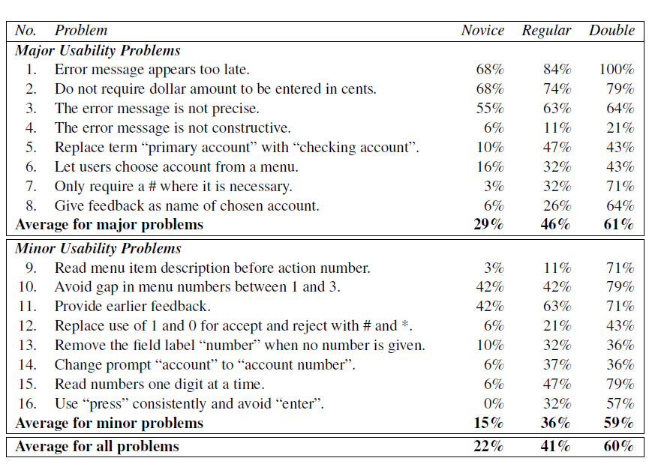
Experience of Evaluators

Slide 8
Experience of Evaluators
Conclusions
Single evaluator finds only small subset of potential problems.
Several evaluators should work independently, then aggregate results.
In Nielsen’s study, finding around 80% of usability problems required 2–3 double specialists, 3–5 regular usability specialists, and around 15 novice usability evaluators.
Note that in practice, heuristic evaluations are usually performed by 3–4 usability specialists.
Evaluators pay more attention to major problems without neglecting minor ones.

Slide 9
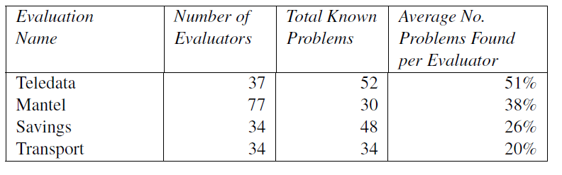
How Many Problems are Found?
Nielsen and Molich ran four heuristic evaluations using “usability novices” as evaluators.
They compared the average number of problems found by each evaluator with the total number of known problems in each system

Slide 10
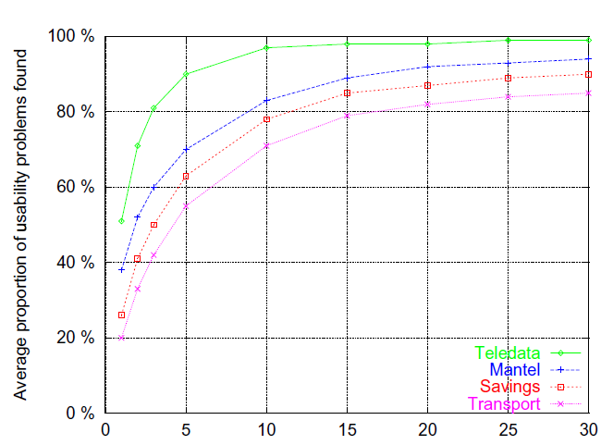
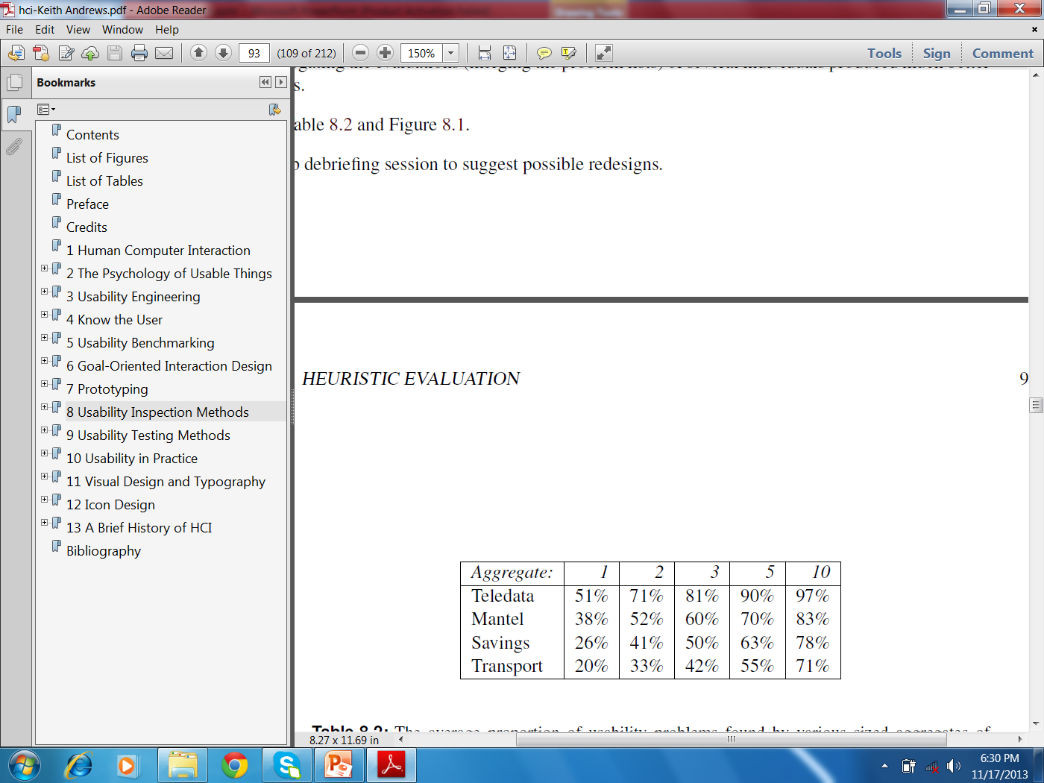
How Many Problems are Found?
Aggregated Evaluations
Individual evaluators found relatively few problems.
Aggregating the evaluations (merging the problem lists) of several individuals produced much better results.

Slide 11
Heuristics
Visibility of System Status [Feedback]
The system should always keep users informed about what is going on, through appropriate feedback within reasonable time.
For example: busy cursor [1–10s], progress indicator [>10s].
Match Between System and the Real World [Speak the Users’ Language]
The system should speak the users’ language, with words, phrases and concepts familiar to the user, rather than system-oriented terms. Follow real-world conventions, making information appear in a natural and logical order.
Match users’ mental model. Beware of misleading metaphors.

Slide 12
Heuristics
User Control and Freedom [Clearly Marked Exits]
Users often choose system functions by mistake and will need a clearly marked “emergency exit” to leave the unwanted state without having to go through an extended dialogue. Support undo and redo.
Consistency and Standards [Consistency]
Users should not have to wonder whether different words, situations, or actions mean the same thing. Follow platform conventions.

Slide 13
Heuristics
Error Prevention
Even better than good error messages is a careful design which prevents a problem from occurring in the first place.
For example: select file from menu rather than typing in name, confirmation before dangerous actions, beware of modes, avoid similar command names, warning if Caps Lock is activated when entering a password, etc.
Recognition rather than Recall
Make objects, actions, and options visible. The user should not have to remember information from one part of the dialogue to another. Instructions for use of the system should be visible or easily retrievable whenever appropriate.
Users’ short-term memory is limited. Provide examples, default values, easily retrievable instructions.

Slide 14
Heuristics
Flexibility and Efficiency of Use [Accelerators]
Accelerators – unseen by the novice user – may often speed up the interaction for the expert user such that the system can cater to both inexperienced and experienced users. Allow users to tailor frequent actions.
For example: abbreviations, command keys, type-ahead, edit and reissue previous commands, menu of most recently used files, macros.
Aesthetic and Minimalist Design [Minimalist Design]
Dialogues should not contain information which is irrelevant or rarely needed. Every extra unit of information in a dialogue competes with the relevant units of information and diminishes their relative visibility. “Less is more”

Slide 15
Heuristics
Help Users Recognise, Diagnose, and Recover from Errors [Good Error Messages]
Error messages should be expressed in plain language (no codes), precisely indicate the problem, and constructively suggest a solution.
Phrase error messages defensively, never blame the user. Multilevel messages. Link to help system.
Help and Documentation
Even though it is better if the system can be used without documentation, it may be necessary to provide help and documentation. Any such information should be easy to search, focused on the user’s task, list concrete steps to be carried out, and not be too large.
Liberal use of examples.

Slide 16
Heuristics
Limits on Response Times
0.1 sec: is the limit so that the system appears to react instantaneously. Important for direct manipulation.
1 sec: is the limit so that the user’s flow of thought stays uninterrupted. Display a busy cursor if things will take longer than 1 sec.
10 secs: is the limit for keeping the user’s attention on the task at hand. Display a progress indicator if things will take longer than 10 secs.

Slide 17
Heuristic Evaluation
Pros and Cons
++ cheap
+ intuitive
+ usable early in development process
+ finds many problems
+ finds both major and minor problems
- may miss domain-specific problems

